Slide 2



Slide 3

eBay Online Shopping Store

Slide 4
eBay Online Shopping Store
Project Name :- eBay Online Shopping Store
Project Domain :- E-Commerce Domain
Project Tech. :- Manual Testing
Approach Followed :- Agile Methodology
Tools Used :- Jira , Google Sheet
Types Of Meetings :- Sprint Planning , Weekly stand Up Meeting
Sprint Review , Sprint Retrospective
Team Size :- 6 Members
Guided By :- Mr. Prasad Deshpande Sir

Slide 5
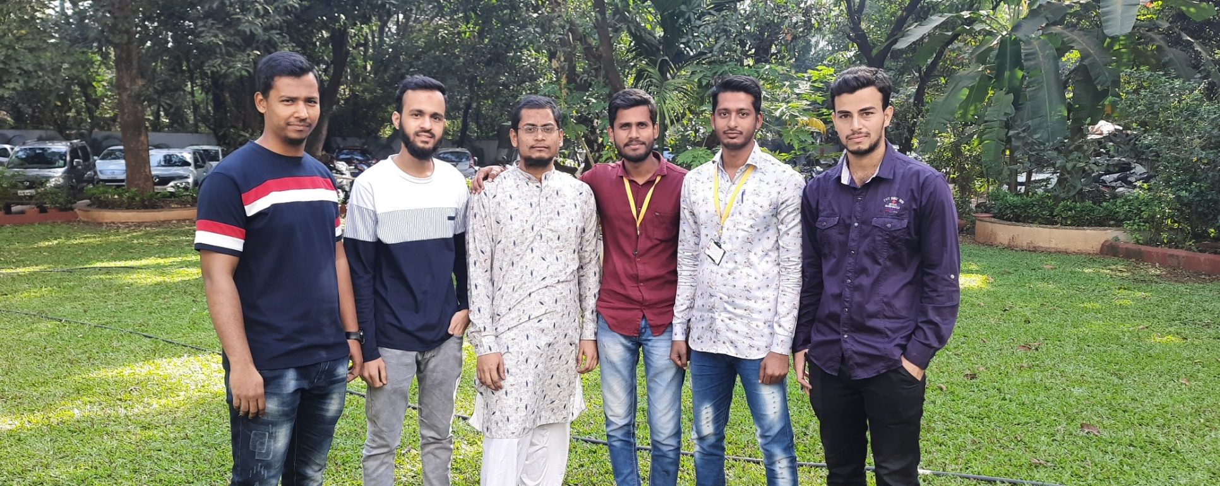
Individual Model Allocation
Obaidullah Khateeb :- Registration & Log Out Module
Mujahid Shaikh :- Login Module
Faiz Ahmad Tadkal :- Profile Edit Module
Faisal Mangalgiri :- Product Booking
Shuaib Tamboli :- Product Purchasing
Mushraf Ali Mucchale :- Message Searching

Slide 6
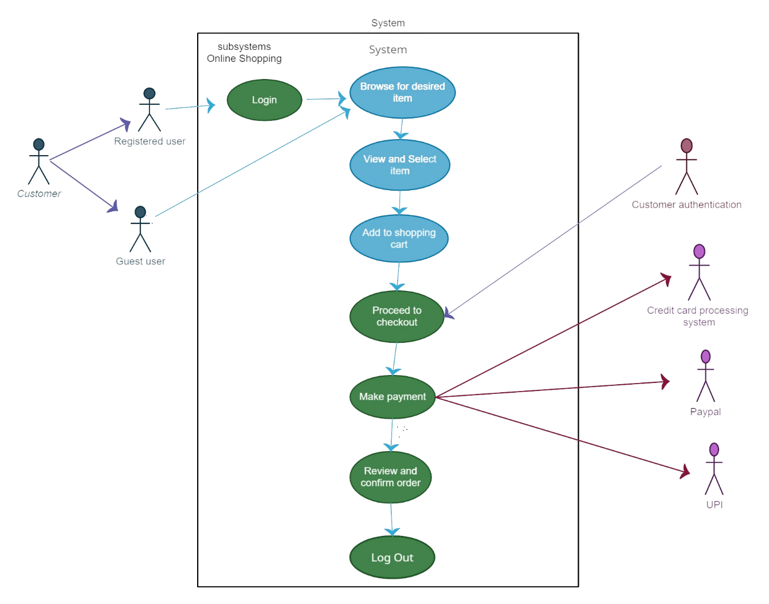
Use Case Diagram

Slide 7
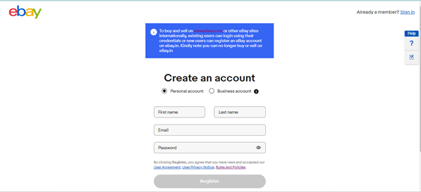
Personal Registration
Allocated to :- Obaidullah Khateeb
User Can Register By Filing Personal Information .

Slide 8
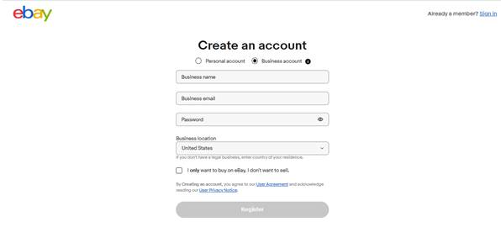
Business Registration
Seller / Business Man Can Register By Filing Business Information .
Allocated to :- Obaidullah Khateeb

Slide 9
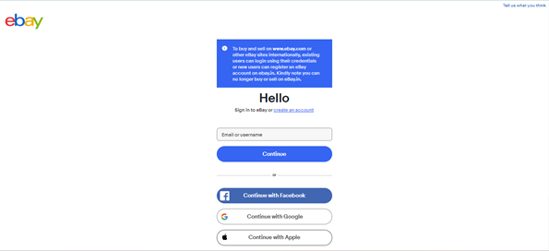
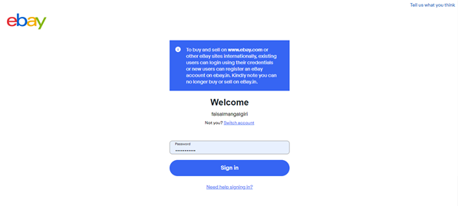
Login Module
Allocated To :- Mujahid Shaikh
User Name Page
Password Page
Only Registered Users Are Allowed To Login By Entering Correct Credentials .
If Wrong Credentials Are Entered Then Access Is Denied .
If User Forgets Password Then Forget Password Option Is Available .

Slide 10
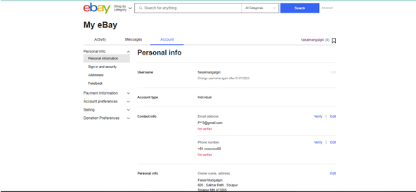
Profile Update Module
Allocated To :- Faiz Ahmad Tadkal
Allows User To Update Vital Information like Email Id ,
Phone No. , Address etc.

Slide 11
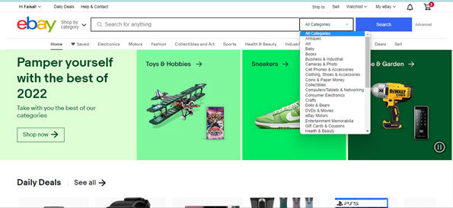
Product Searching Module
Allocated To :- Faisal Mangalgiri
Allows User To Search Desired Products From Various Categories
Allowed For Registered And Non-Registered Users

Slide 12
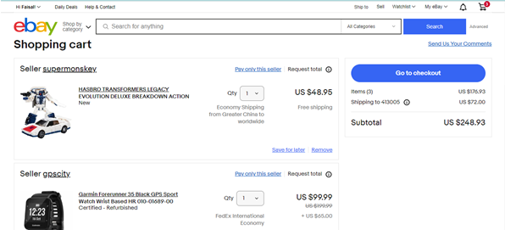
Cart
Allocated To :- Faisal Mangalgiri
Allows To View Products Which Are Added To Cart
Allows To Make Payment

Slide 13
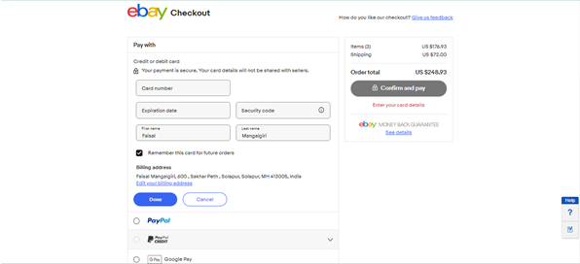
Payment Module
Allocated To :- Shuaib Tamboli
Allows To Pay By Various Methods Like Credit / Debit Cards ,
PayPal , UPI

Slide 14
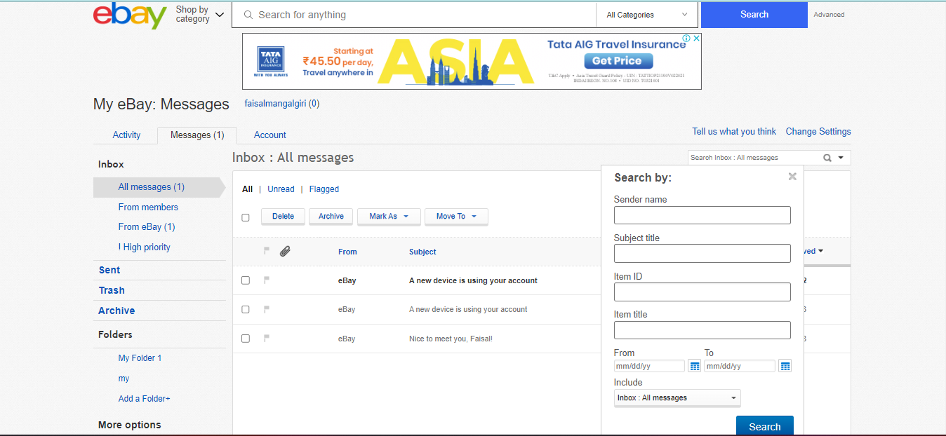
Message Searching Module
Allocated To :- Mushraf Ali Mucchale
Allows To Search , Sort , Save & Delete Messages (Mails)
Allows To Make Folder For Saving Messages

Slide 15
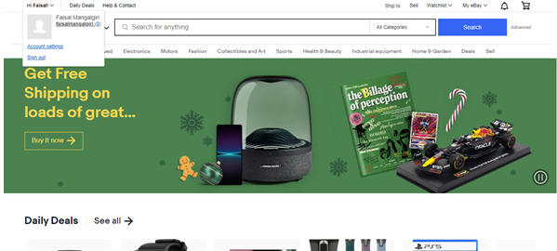
Log Out Module
Allocated To :- Obaidullah Khateeb
Allows To Log Out User From Shopping Site After Completing All Tasks .
User Can Log In Again With Same Or Different Account

Slide 16
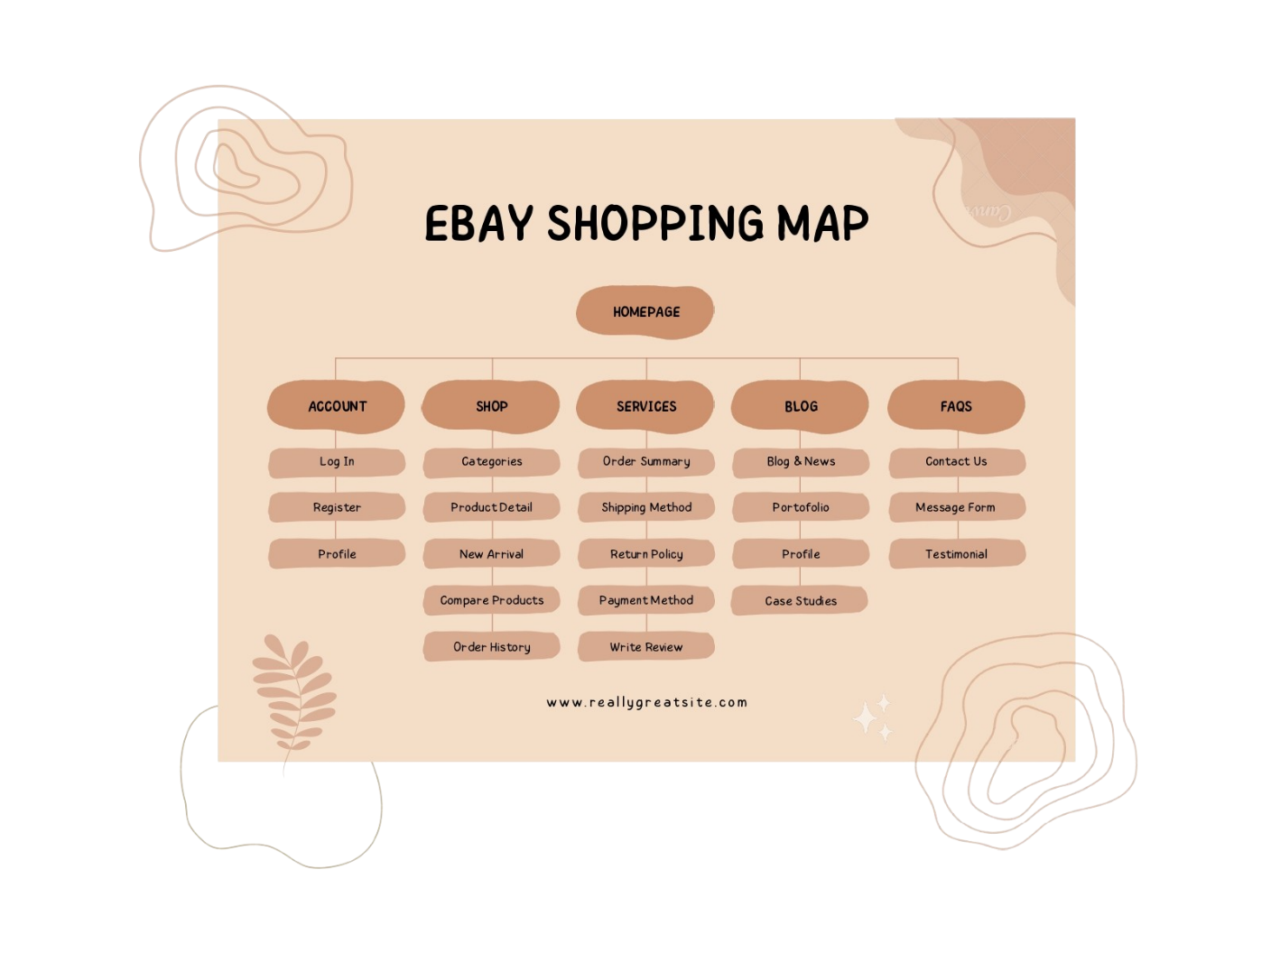
Flow Chart

